Slide 1
GRAMS PDU Grounding Configuration
Dave Durachka, Code 564

Slide 2
List of Sub-Systems in the PDU
Cold Time-Projection Chamber
Houses the SiPM Power Boards (x6), the SiPM Pre-Amplifier, Charge Pre-Amplifier, as well as Telemetry Power Boards
The High Voltage Board Inside the pressure vessel is also part of the Cold TPC section.
Warm Time-Projection Chamber
Houses the Shaper Power board, as well as the data acquisition power boards
CPU
Hub CPU and DAQ CPU power boards are housed here
Time of Flight Section
This houses the Time-Of-Flight Power Board.

Slide 3
Design Philosophy
Each of the sub-systems will be powered from a single DC-DC Conversion done on the Main PDU Box. This box will receive the +28V from the battery pack on the balloon gondola and convert down to +12V that will drive each Sub-System’s PDU Board.
Each sub-system will have a dedicated power board that will receive the +12V and convert down or up to the prescribed value needed for the sub-system.
Requirements have been captured for the PDU system and agreed to by everyone.
An Interface Control Document (ICD) will accompany this presentation to provide completeness to this design.

Slide 4

Harnessing Nomenclature
Classes of Harnessing
Input Power Cables to the PDU (Preceded with a P) at the box level
Telemetry Cables within the PDU (Preceded with a T) at the box level
Cables providing power From the PDU (Preceded with a J) at the box level

Slide 5
COLD TPC PDU

Slide 6
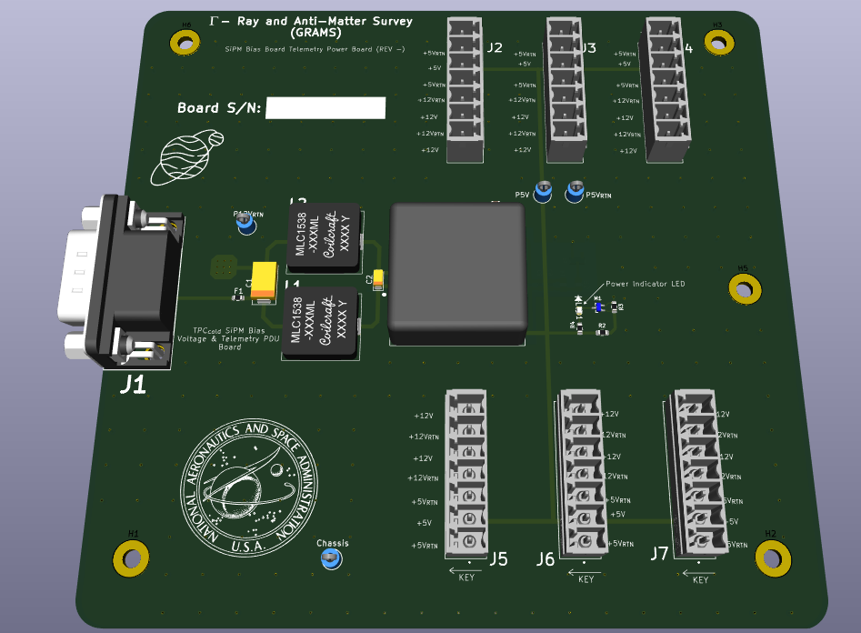
Cold TPC SiPM Bias Power Board
The Image to the left is describing the board providing power for both the SiPM Bias as well as the telemetry section of the SiPM Bias Board.
J2 – J7 will provide +12V and +5V to each SiPM Bias Board.
This board will receive +12V from the Main DC-DC PDU Board.

Slide 7
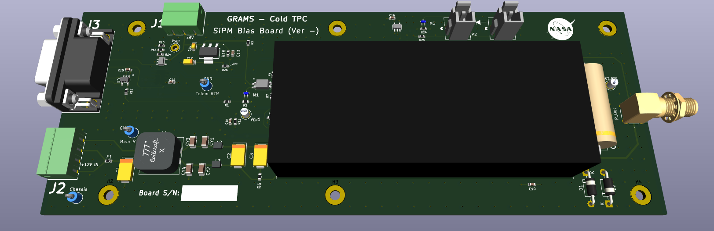
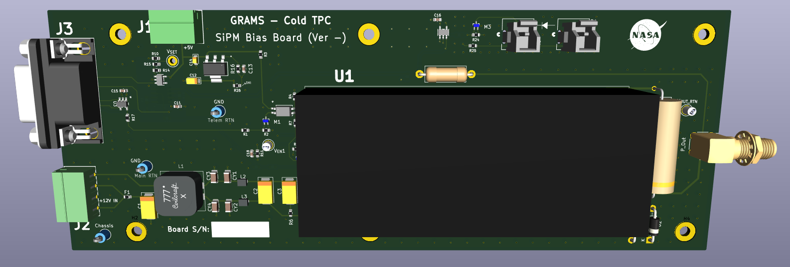
Cold TPC SiPM Bias Board
The SiPM Bias Board is shown to the Right.
J1 and J2 receive the +12V and +5V (with returns) respectively.
J3 is the command / control, and telemetry portal to this board.
U1 is the 1/16A12-P4-I5 converter manufactured by Ultravolt and will provide the prescribed voltage rail to each SiPM within the Cold TPC Section.

Slide 8
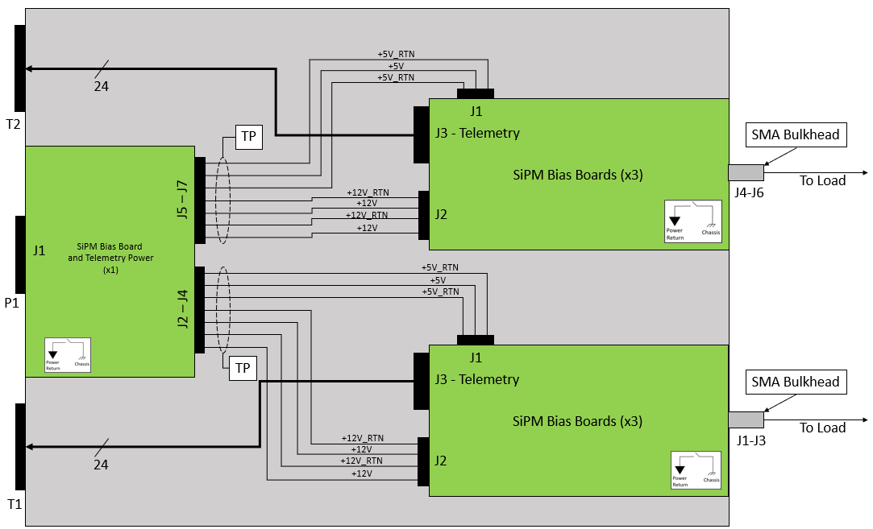
Cold TPC SiPM Bias Box Wiring Diagram
Chassis

Slide 9
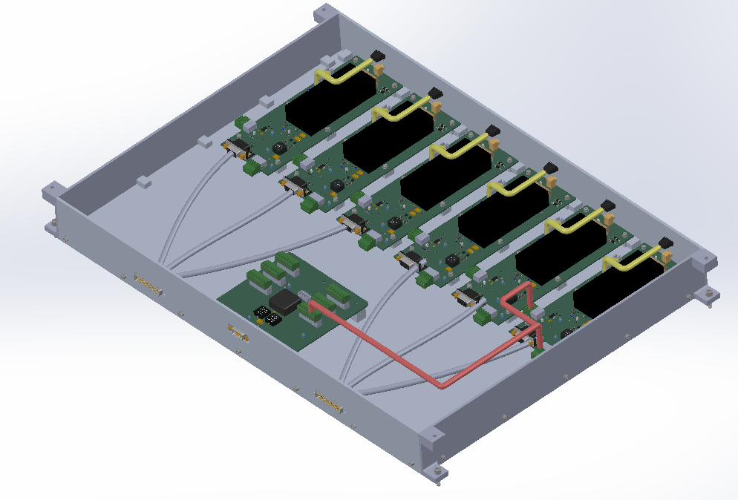
Cold TPC SiPM Bias Box Design

Slide 10
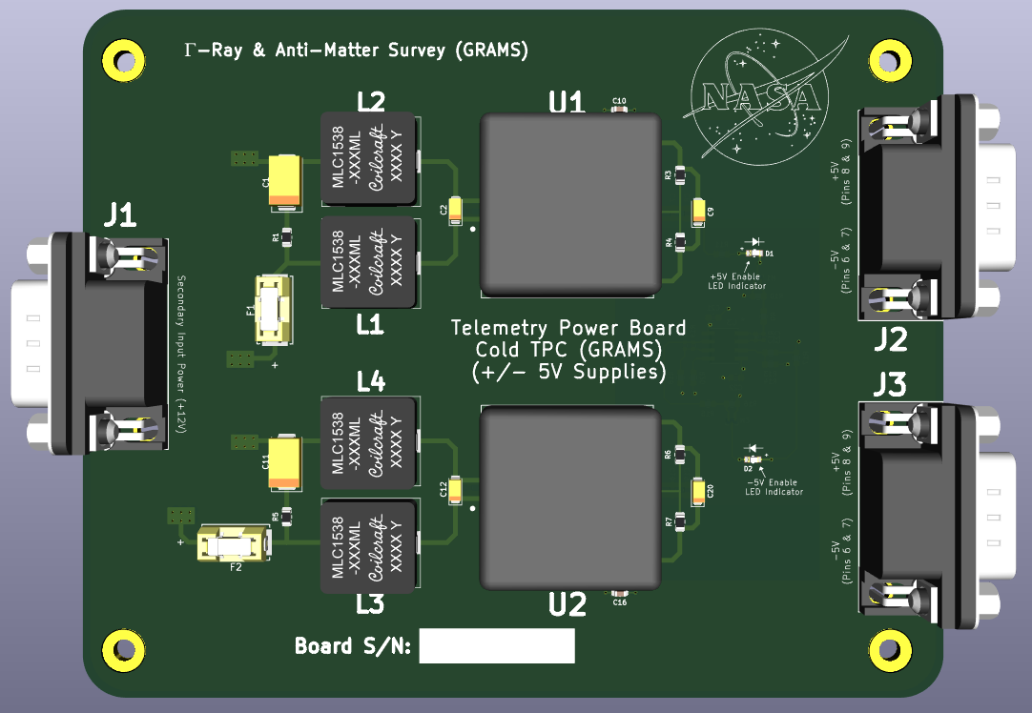
Cold TPC Charge and SiPM Pre-Amp Power Board
The image to the left describes the power board providing +/- 5V for the telemetry sections of the PDU Boards servicing the Charge and SiPM Pre-Amplifier Sub-Systems

Slide 11
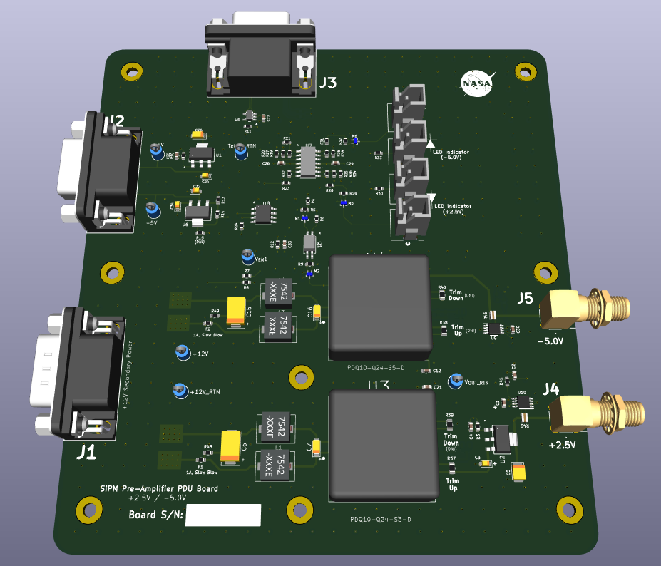
SiPM Pre-Amplifier Board
The Image to the Right is showing the SiPM Pre-Amplifier PDU Board.
J1 receives +12V from the Main PDU Board
J2 receives the +/- 5V from the Charge and SiPM Pre-Amplifier Board shown in the previous slide.
J3 Provides the telemetry from this board.
J4 and J5 deliver +2.5 / -5 respectively to the load.

Slide 12
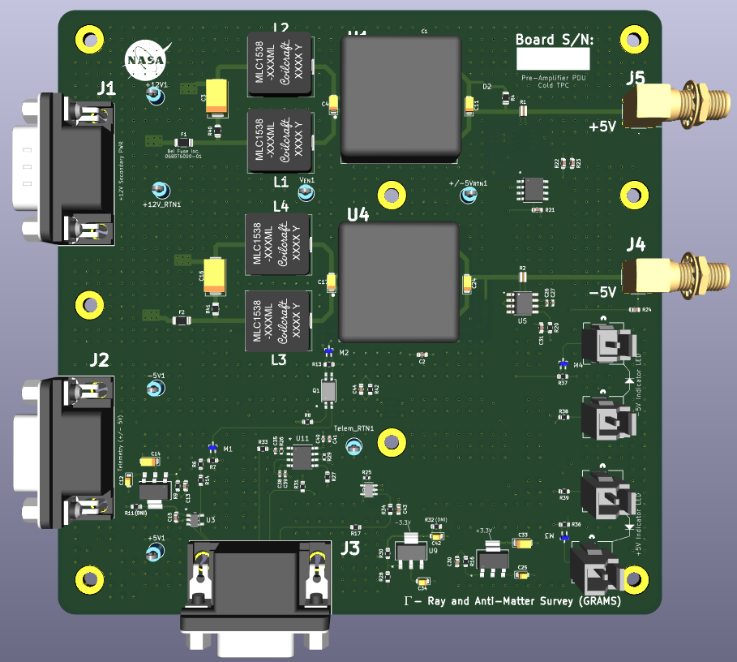
Charge Pre-Amplifier Board
The image to the right is showing the Charge Pre-Amplifier PDU Board
J1 is receiving the +12V from the Main PDU Board
J2 is receiving the +/- 5V from the Charge and Pre-Amplifier Power board
J3 is providing the telemetry from this board
J5 and J4 are providing the +/- 5V to the Load.

Slide 13
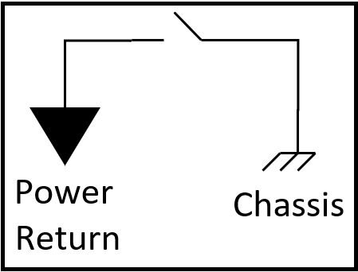
Cold TPC Charge and SiPM Pre-Amp Box Wiring Diagram
15
Telemetry Values
SiPM Pre-Amplifier PDU Board
T3
J3 (Telem)
8
+12V
8
+/- 5V
+12V_RTN
+/- 5V_RTN
J2 (Telem power)
P2
J7
(-5V) J5
To Load
J1 (Main Power)
(+2.5V) J4
To Load
SiPM and Charge Pre-Amp Power Board
J8
J9
J1 (Main Power)
(+5V) J5
To Load
P3
(-5V) J4
To Load
8
+12V
8
J10
+12V_RTN
+/- 5V
J2 (Telem power)
+/- 5V_RTN
P4
J3 (Telem)
12
Charge Pre-Amplifier PDU Board
Telemetry Values
T4
* All harnessing called out in this drawing are Twisted Pair

Slide 14
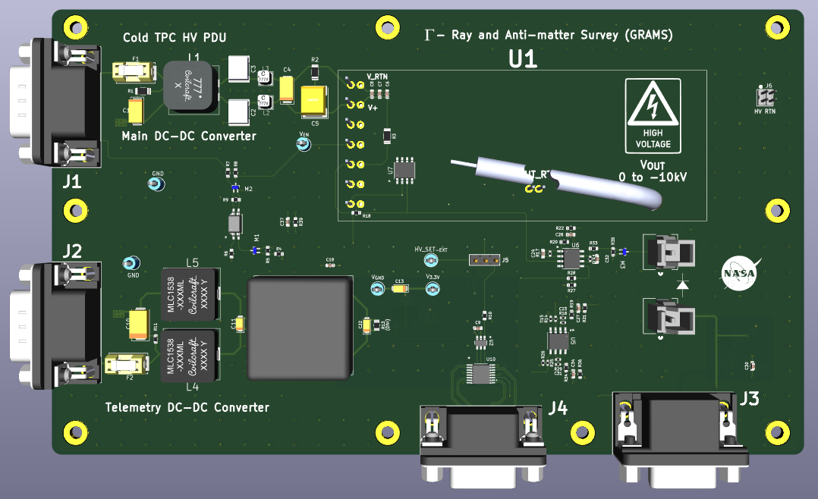
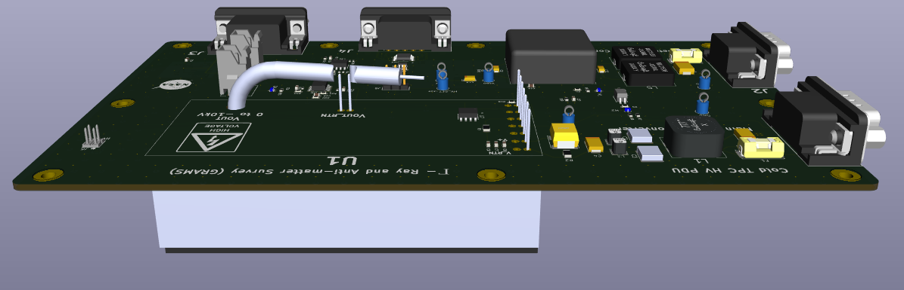
High Voltage Bias (-10kV) for Cold TPC
Images to right show the HV PDU board for the Cold TPC
J1 and J2 receive the main input power of +12V. The pinout orientation are identical, swapping these will not harm anything.
J3 is the Telemetry I/O
J4 provides a means to configure he onboard DAC and provide the enable signal. This board will reside in its own box.
DC-DC Converter resides on bottom of the board

Slide 15
Backup Slides

Slide 16
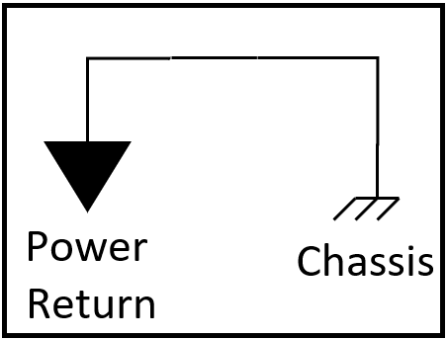
Cold TPC PDU Section
SiPM Bias Boards (x6)
SiPM Pre-Amp & Charge Pre-Amp
Main DC-DC
Converter Board
+28V
-10kV HV PDU
=
+12V
=
+12V RTN
+28V RTN
Warm TPC PDU Section
Caen/Nevis DAQ
Shaper
Flight Computer
HUB and DAQ Computer PDUs
Power
Return
Chassis

Slide 17
SiPM Bias Box (Cold TPC) Wiring Diagram
+5V_RTN
+5V
24
+5V_RTN
T2
J1
TP
J3 - Telemetry
SMA Bulkhead
SiPM Bias Boards (x3)
To Load
J5 – J7
+12V_RTN
J4-J6
+12V
J2
+12V_RTN
+12V
J1
SiPM Bias Board
and Telemetry Power
(x1)
+5V_RTN
+5V
P1
+5V_RTN
J2 – J4
TP
J1
J3 - Telemetry
SMA Bulkhead
SiPM Bias Boards (x3)
To Load
+12V_RTN
J1-J3
+12V
J2
24
+12V_RTN
+12V
T1

